Slide 1
ML FOR CS:GO
PRESENTED BY -
CHAITRALI KSHIRSAGAR
RAGHAK RADHAKRISHNAN
SRIRAM GIRIDHARAN

Slide 2
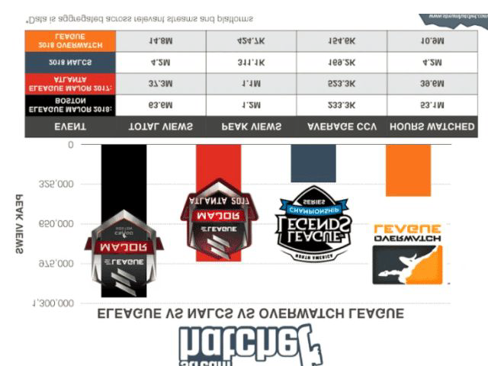
INTRODUCTION
ESports has been gaining attention similar to real life sports and is rapidly growing.
Esports championship events stream live globally, where audiences can interact with each other and the broadcaster through chat in real time.

Slide 3
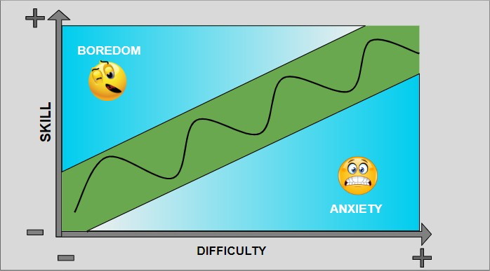
GOAL AND MOTIVATION
GOAL - To capture Macro flow in a game from audience perspective.
MOTIVATION - Game flow design is generally developed for players, but it is also important for live games to engage audience for long time.
Capture flow between game and audience involvement using commentary audio, game video frames and live Twitch data.

Slide 4
DATA COLLECTION
Starladder Major Berlin 2019 Championship from CS:GO News & Coverage | HLTV.org
VIDEO - Downloaded final gameplay video of ~ 1 hour. Converted entire video in frames of 1 fps for vision pipeline.
AUDIO - Extracted only audio from the gameplay video.
TWITCH DATA - Downloaded live Twitch chat data log for the final gameplay.

Slide 5
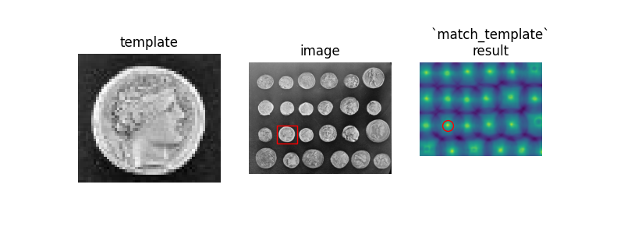
THE VISION PIPELINE
IDEA - Capture interesting events and happenings in the game trusted to create emotions for audience. Example: kills, planting bombs etc.
Locations of interesting features at fixed coordinates in each frame.

Slide 6
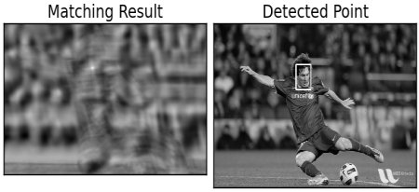
TEMPLATE MATCHING
Extract required template to be matched for every frame.
Use cv.matchTempate() which locates regions in input image which match template using a metric CV_TM_CCOEFF_NORMED.
Once matches are obtained, locations are selected based on a threshold (hyperparameter).
Non-maximum suppression is applied to determine the exact number of detections.

Slide 7
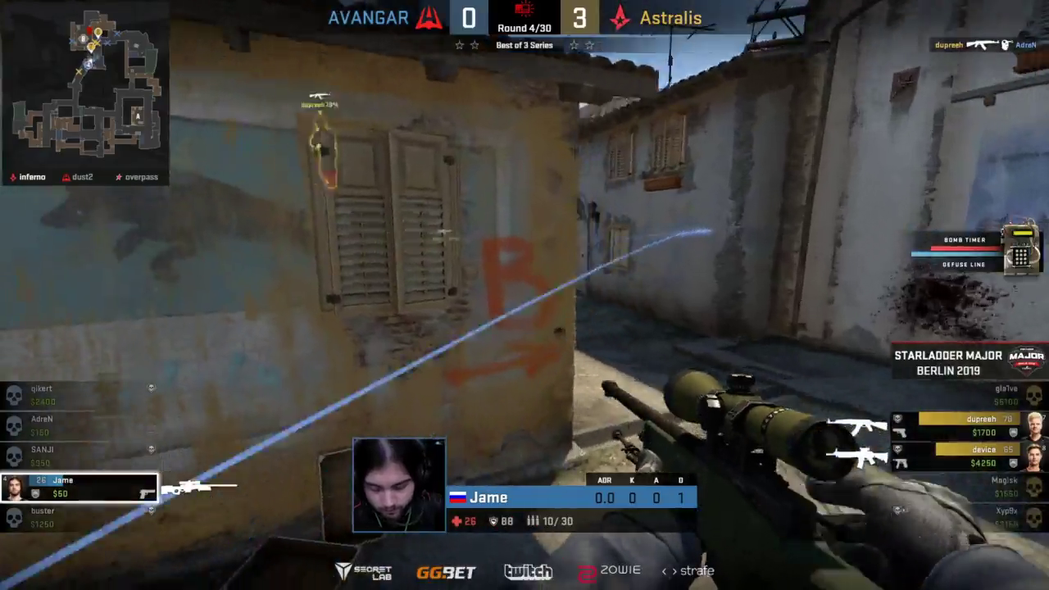

Slide 8
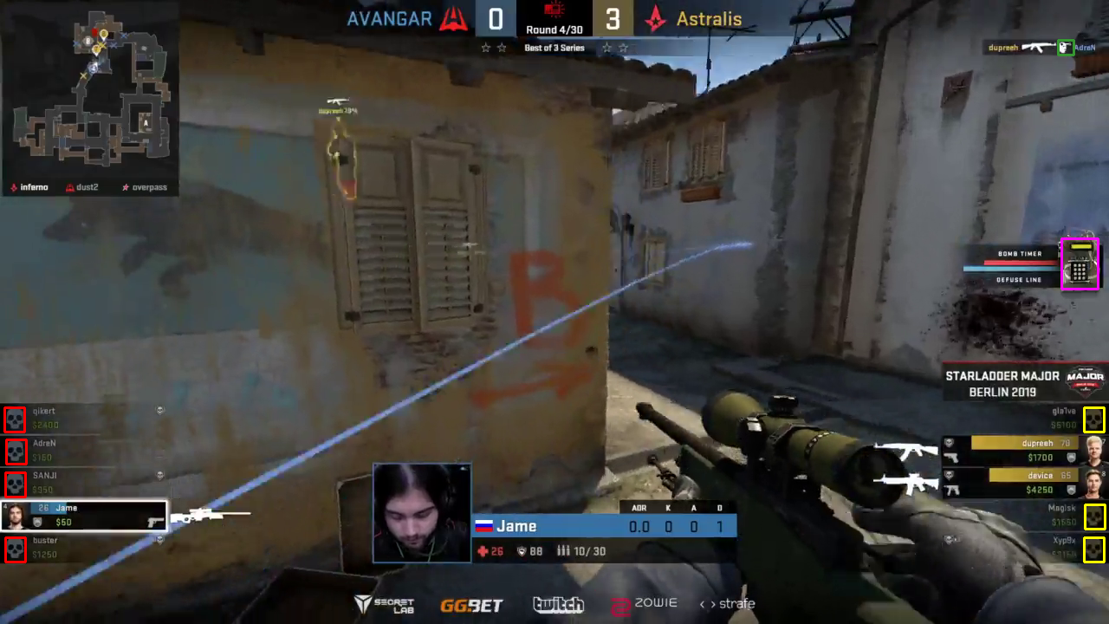

Slide 9
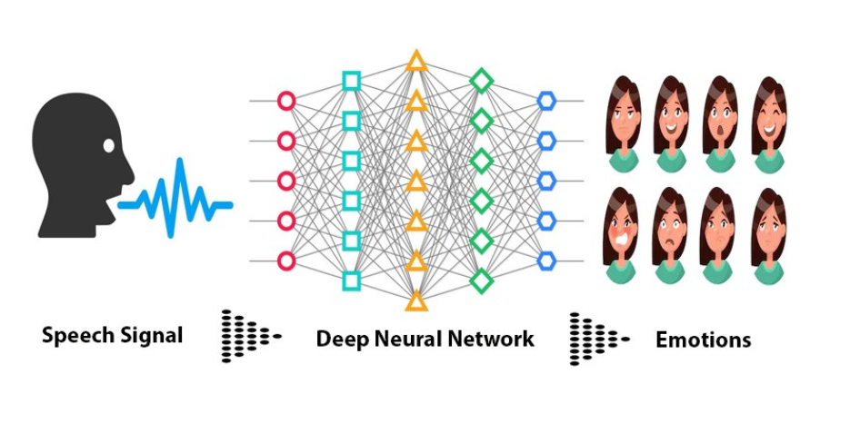
THE AUDIO PIPELINE
Split the audio from the Twitch Championship video.
To extract the speech, split into a mono channel and feed it to a Voice Activity Detector.
The Voice Activity Detector will separate out the speech part from the commentary.

Slide 10
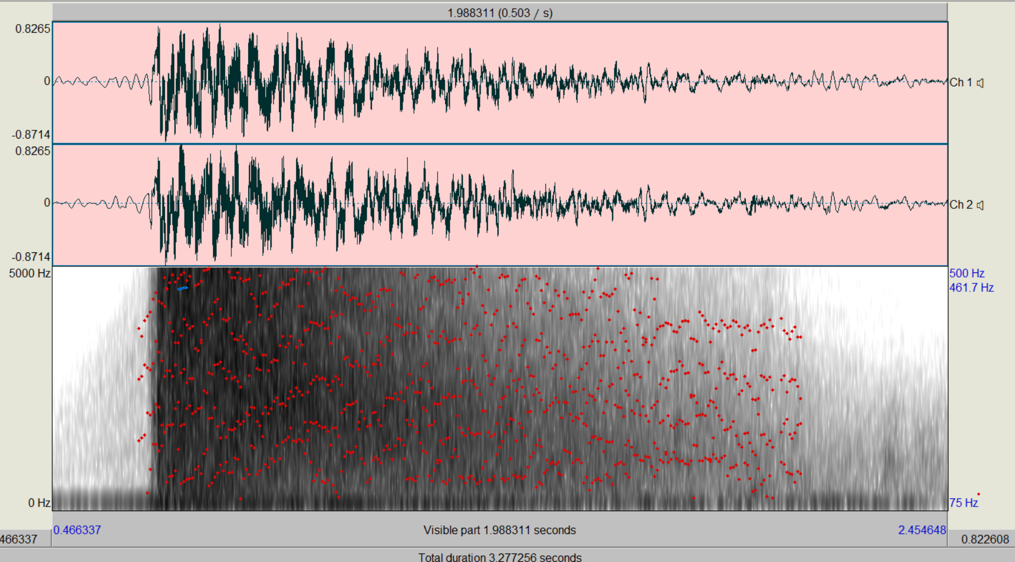
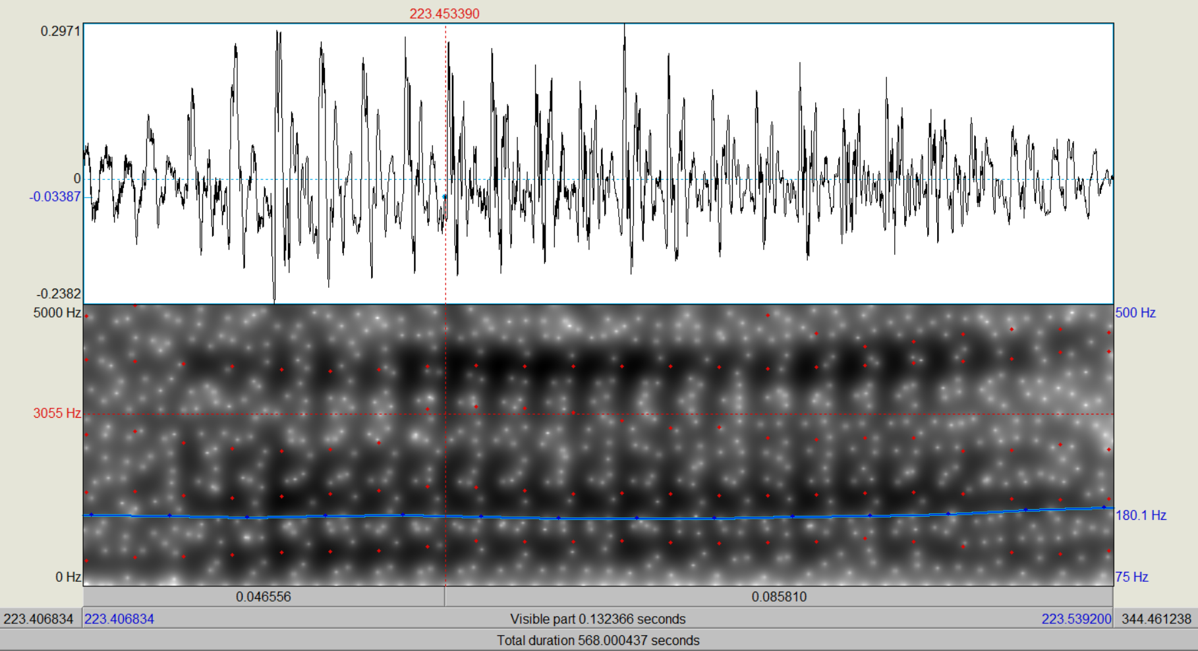
Voice Activity Detector
Audio signal of the AWP gun shot
Audio signal of the speech part

Slide 11
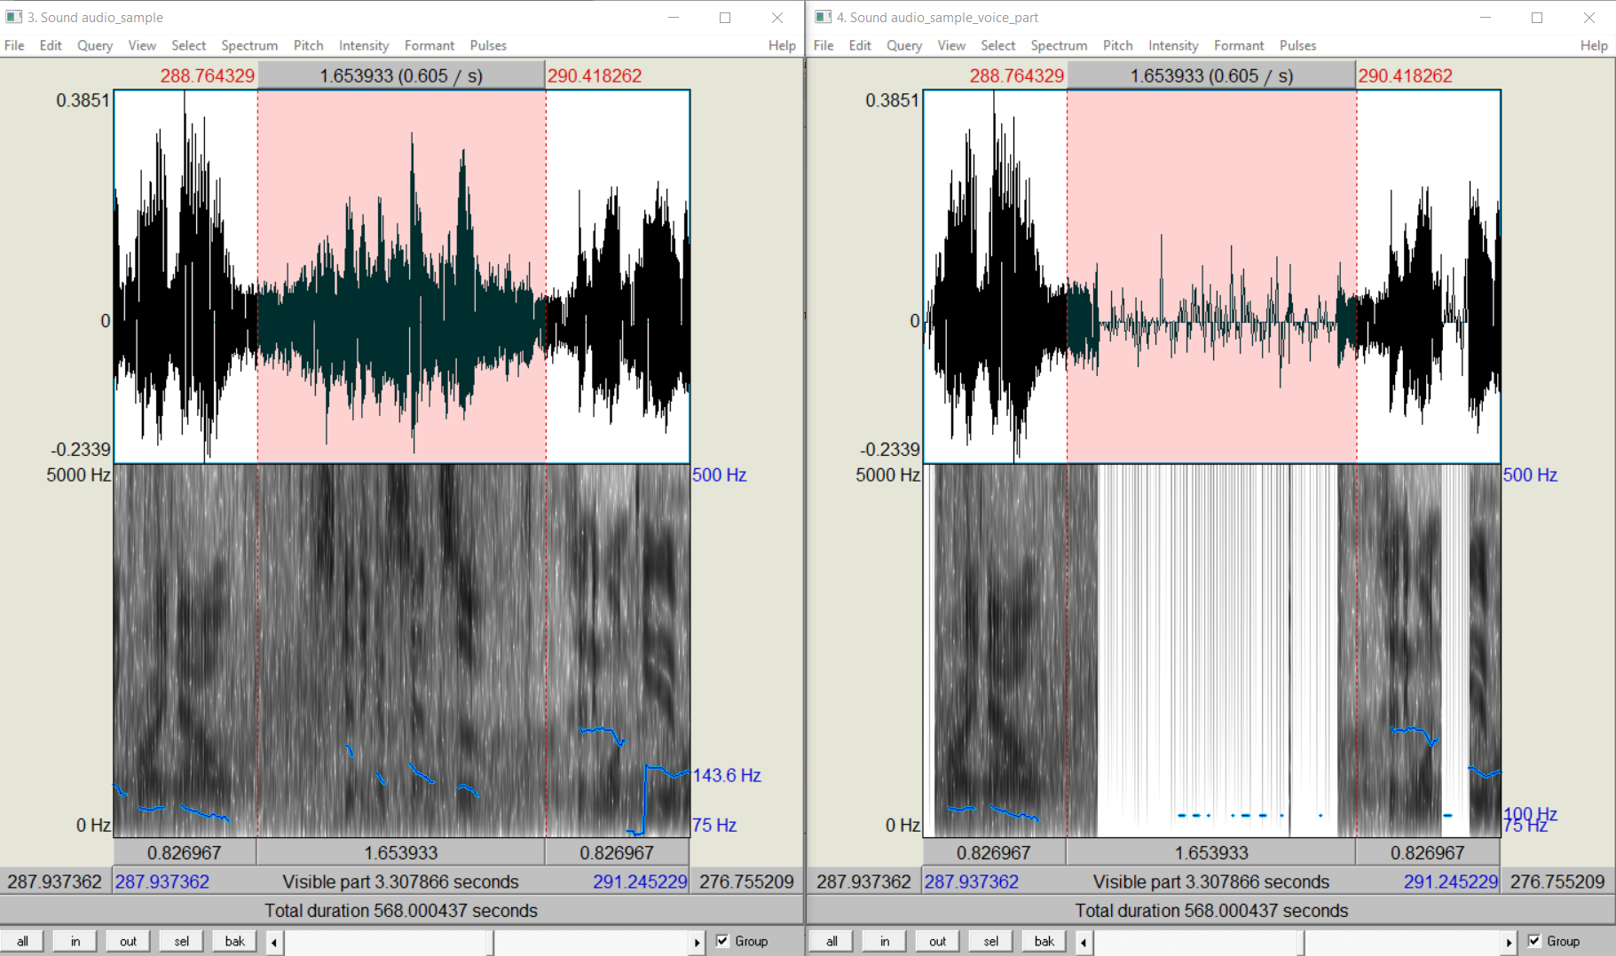
Voice Activity Detector

Slide 12
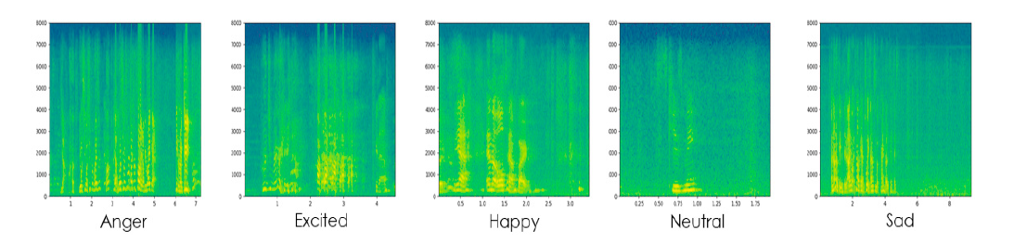
EMOTION RECOGNITION
Ref: A CNN-Assisted Enhanced Audio Signal Processing for Speech Emotion Recognition Sensors 2020, 20, 183; doi:10.3390/s20010183

Slide 13
EMOTION RECOGNITION
_________________________________________________________________
Layer (type) Output Shape Param #
=================================================================
conv1d_1 (Conv1D) (None, 40, 128) 768
_________________________________________________________________
activation_1 (Activation) (None, 40, 128) 0
_________________________________________________________________
dropout_1 (Dropout) (None, 40, 128) 0
_________________________________________________________________
max_pooling1d_1 (MaxPooling1 (None, 5, 128) 0
_________________________________________________________________
conv1d_2 (Conv1D) (None, 5, 128) 82048
_________________________________________________________________
activation_2 (Activation) (None, 5, 128) 0
_________________________________________________________________
dropout_2 (Dropout) (None, 5, 128) 0
_________________________________________________________________
flatten_1 (Flatten) (None, 640) 0
_________________________________________________________________
dense_1 (Dense) (None, 8) 5128
_________________________________________________________________
activation_3 (Activation) (None, 8) 0
=================================================================
Total params: 87,944
Trainable params: 87,944
Non-trainable params: 0
_________________________________________________________________

Slide 14
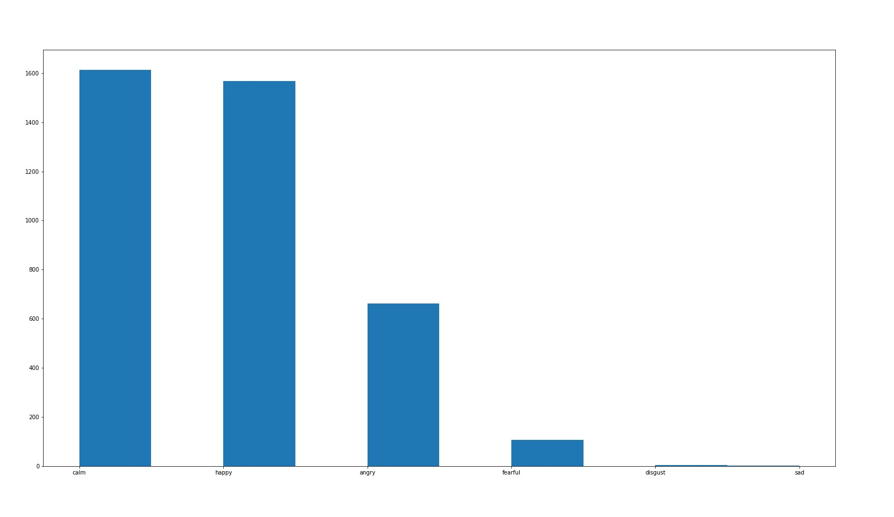
EMOTION RECOGNITION
Histogram of the emotion detected

Slide 15
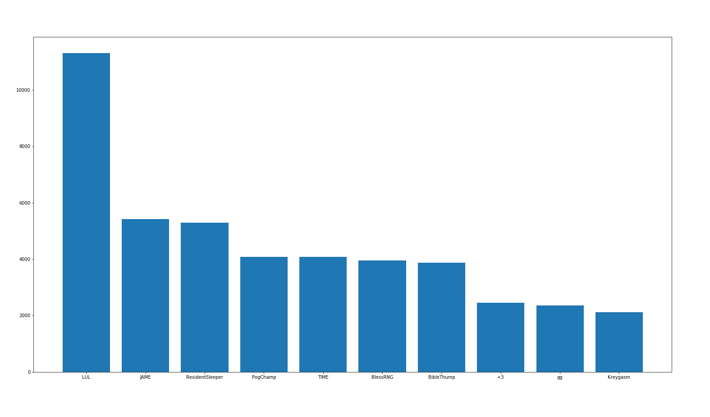
THE TWITCH CHAT PIPELINE
The twitch chat is extracted using a Twitch Chat Downloader API.
Data chat log: For game on average of 3.5 hours with 250k words has 31K Unique words.
Preprocessing: Most frequent 1000 words extracted along with their timestamp

Slide 16
DEMO...

Slide 17
GOALS ACHIEVED AND NEXT STEPS ...
Preprocessing of Vision and Speech complete.
Labels to depict flow between game and audience captured.
Train a RNN and CNN to learn features corresponding to acquired labels.
Formulate a graph to indicate how the flow happens in real time.

Slide 18
THANK YOU!

